Slide 1


_{Health Care System}
Application Engineering & Development [INFO 5100]
Rucha Mangalekar
Ayushi Patel
Maurya Ramteke
002106988
002925618
002980963

Slide 2

Problem Statement
The health-care industry wants to classify patients based on their pathology data in order to improve their CARE (Self-management, Doctor-Advise, Further Diagnostic, and Chronic Medication) management, which will allow them to create a multi-classification model to build a CARE Management Model with the adequate patient classification.
The healthcare system had to coordinate with numerous departments, such as the necessity for timely vaccination, ventilators, and the effects on people's health difficulties, such as heart disease and other consequences.
A large number of front-line fighters were involved in the emergency, including doctors, COVID-19 emergency teams, government officials with vaccination teams, ambulances, the pharmacy industry with drug supply, and vital devices such as ventilators for the people's survival.
This situation resulted in abrupt changes in the healthcare system, as they were required to be more responsive and conscientious, as well as the government's involvement in tracking vaccinations provided, following up on individual's health status after recovering from the disease, supplying necessary medicines and devices, and ensuring that all emergency response teams are intact and provide on-time services.

Slide 3
Proposed Solution
Healthcare System is an application which incorporates all the functionalities of a hospital which includes scheduling patient’s appointment to completing their treatments, medications and follow up on the patient’s health conditions even after the treatment.
It is intended to replace any hospital's existing manual paper-based system. The new system is designed to keep track of patient information. Room availability, staff and operating room scheduling, and patient's bills are all important factors to consider. These services must be delivered in a timely and cost-effective manner, with the goal of lowering the amount of time and resources now necessary for such jobs.
Second, the healthcare system entails working with government agencies to schedule vaccinations for the covid-19 disease, as well as emergency response agencies such as the covid-19 task force, ambulances, and a device management team to provide required equipment to patients after their treatment.
The application shows the statics and reports for the cardiac immunity in the people during the covid-19 pandemic.
The application, which was developed in partnership with government enterprises, maintains track of the covid-19 instances in the country, as well as the vaccinations given to the population and the overall process development.

Slide 4
Key Functionalities
Scheduling of appointments with the Doctor on an available time slot.
Covid-19 testing before doctor’s appointment and getting immediate report .
Appointment confirmation of the user with the doctor and providing prescription for aliments diagnosed.
Device system for delivering necessary devices to patient based on the prescription.
Cardiac patients are monitored all the times during the medication
In all instances, the Covid-19 emergency reaction team is always available.
Administrating the drugs/medicines in Pharmacy
Updating of the device stocks in the ‘Device Registry’ on a timely basis
Registration for vaccination
Covid-19 task force ,medical emergency teams available all the time.
Generating the statistics and the reports for the cardiac immunity in the people during the Covid-19 Pandemic
Creating the reports of number of Covid-19 cases
Generating the reports of number of people vaccinated against the Covid-19 cases.

Slide 5
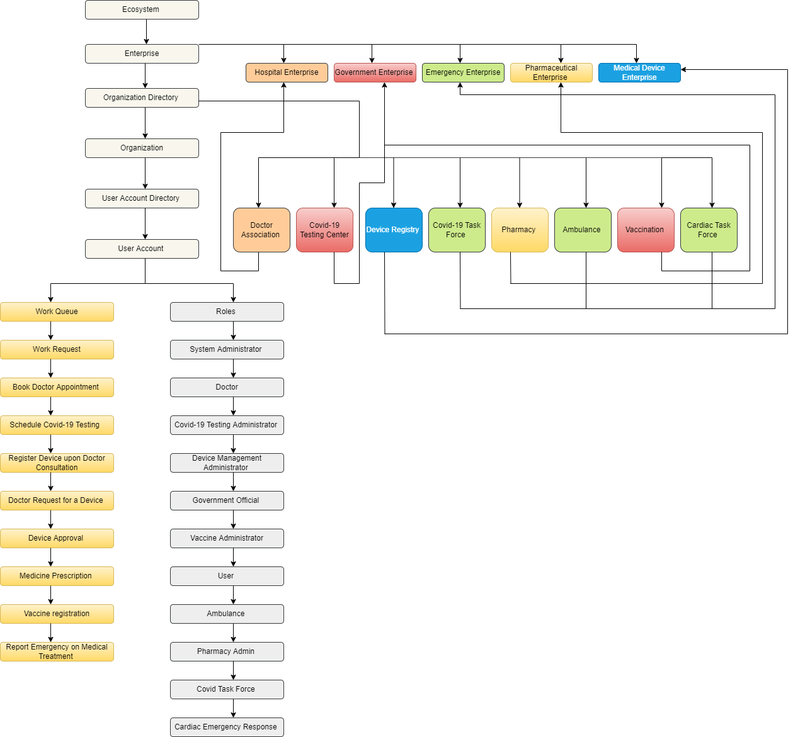
Ecosystem Model

Slide 6
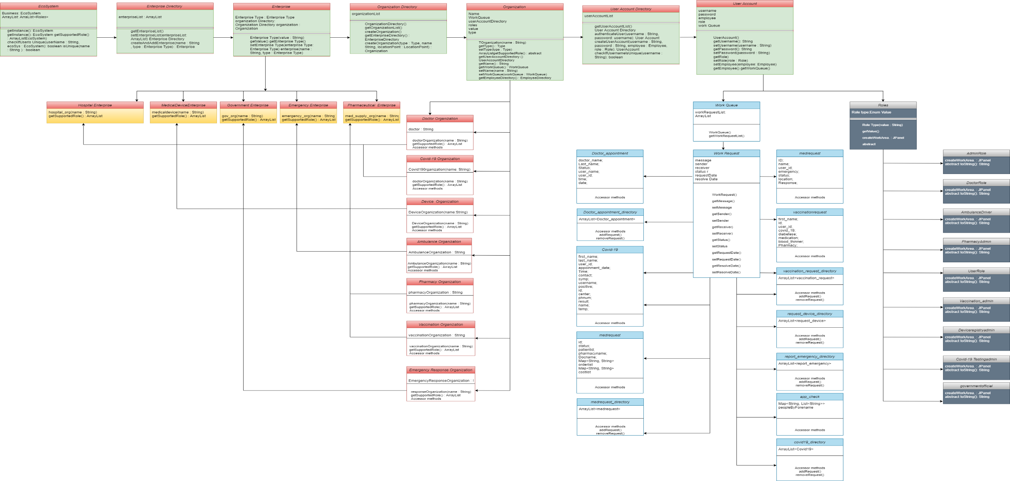
UML Diagram

Slide 7
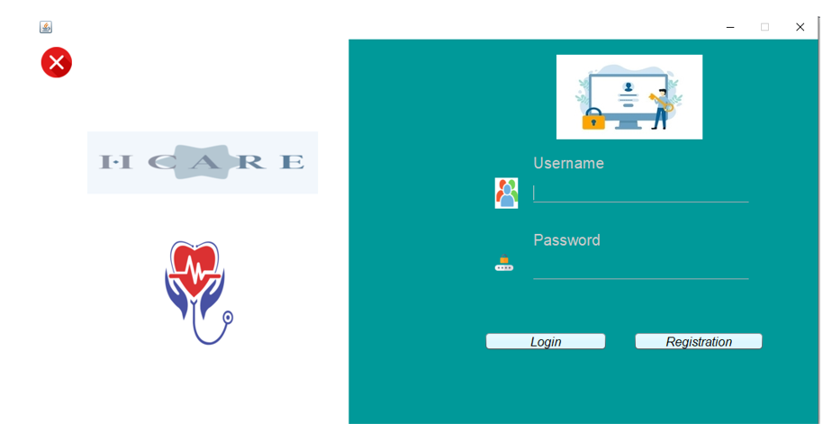
LOGIN PAGE

Slide 8
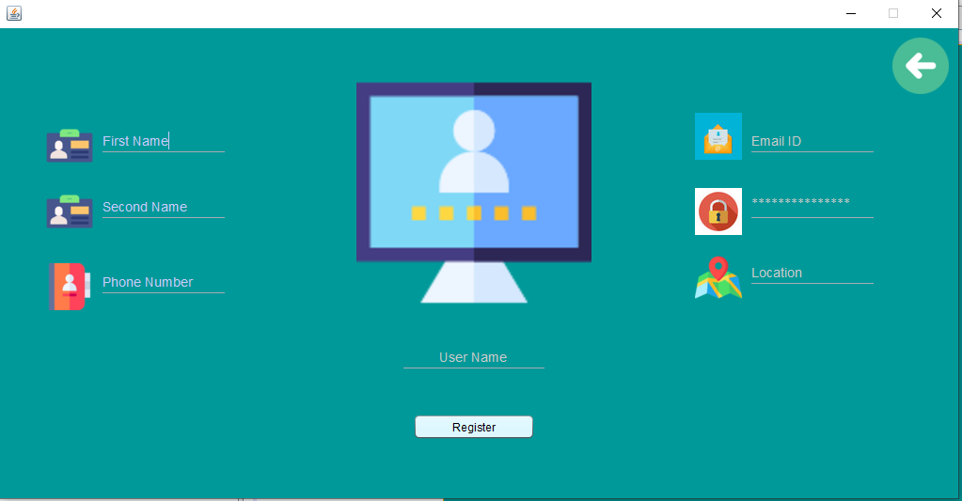
REGISTRATION PAGE

Slide 9
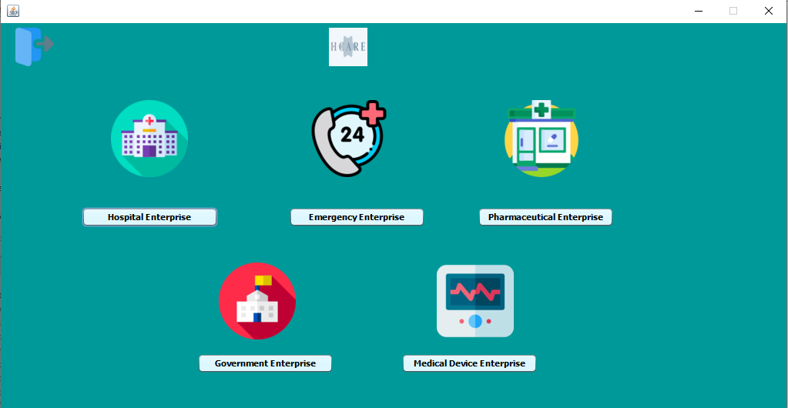

Slide 10
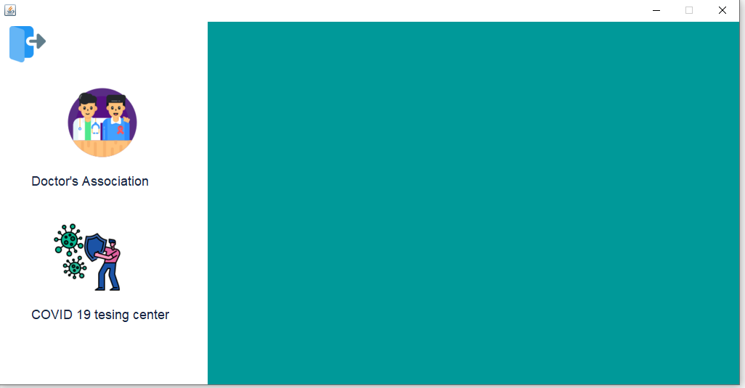
HOSPITAL ENTERPRISE

Slide 11
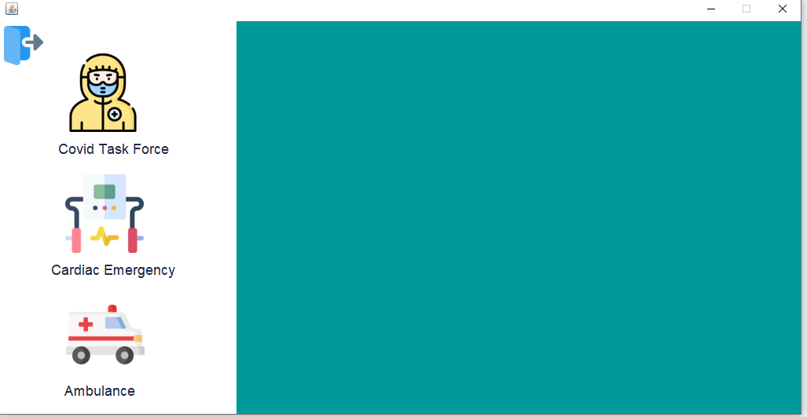

Slide 12
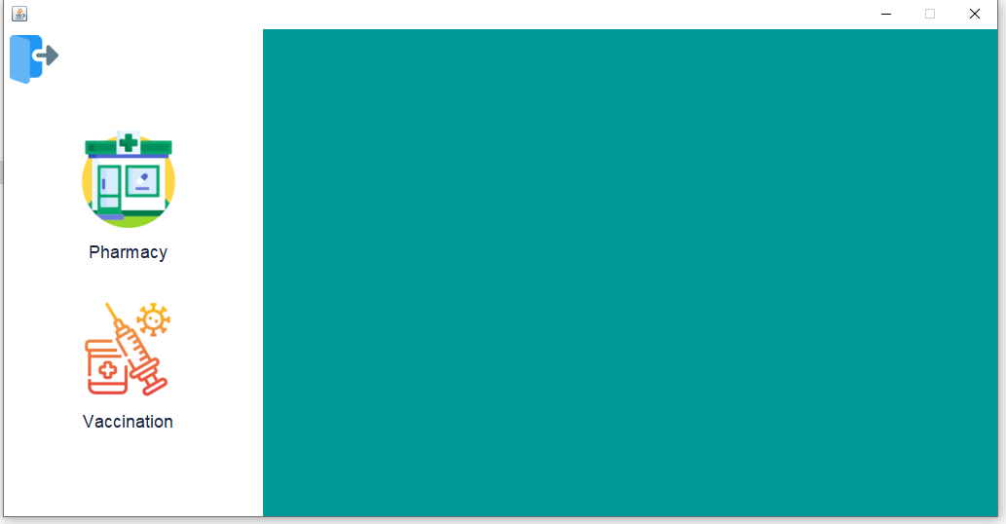
PHARMACY ENTERPRISE

Slide 13
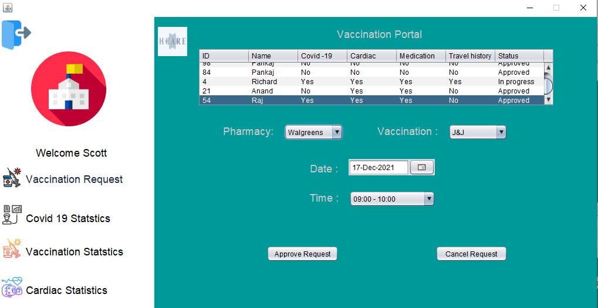

Slide 14
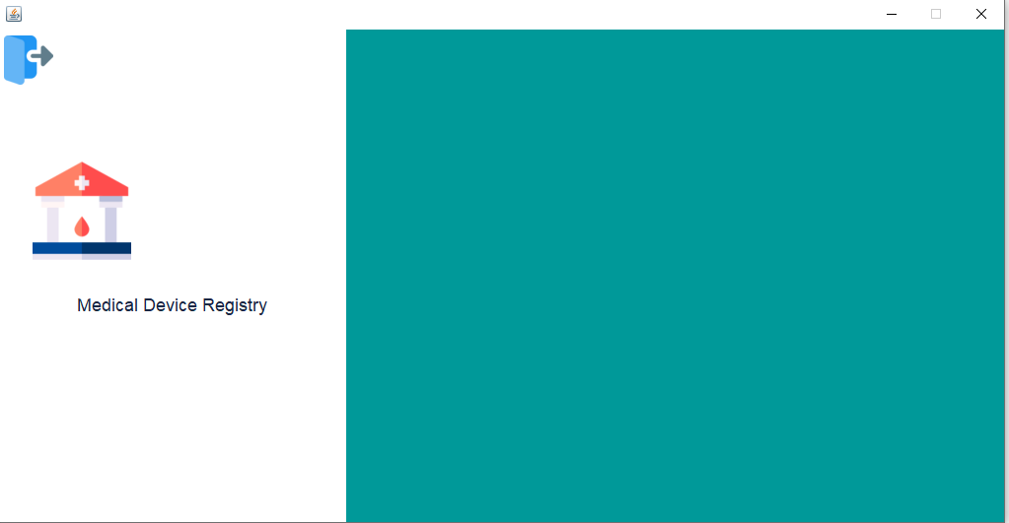
DEVICE REGISTRY

Slide 15
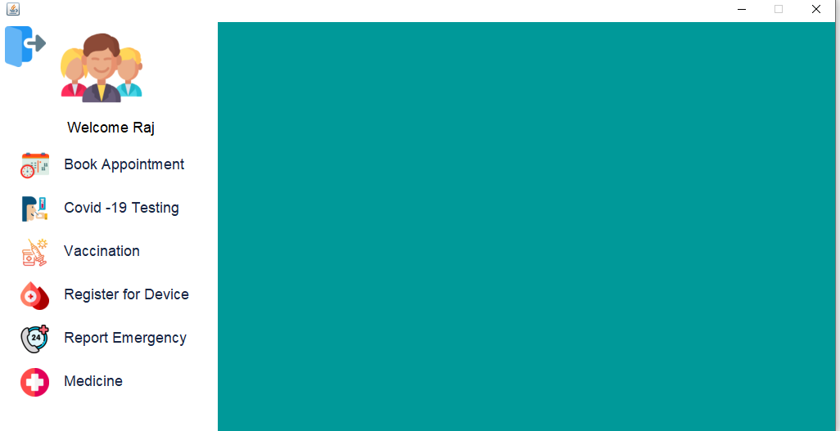

Slide 16
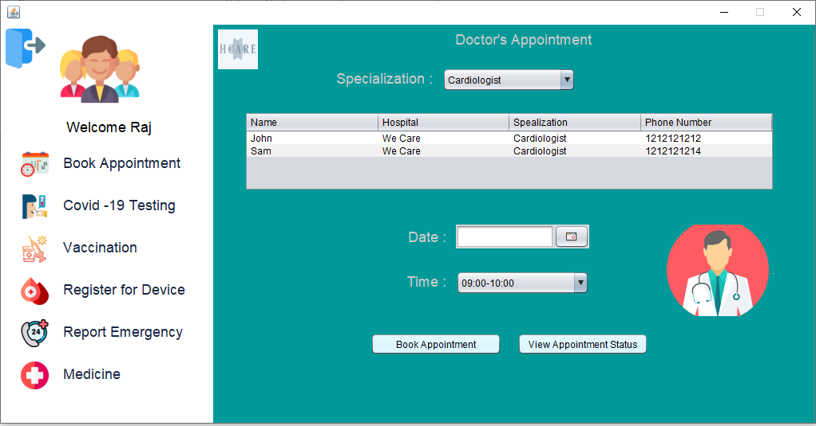

Slide 17
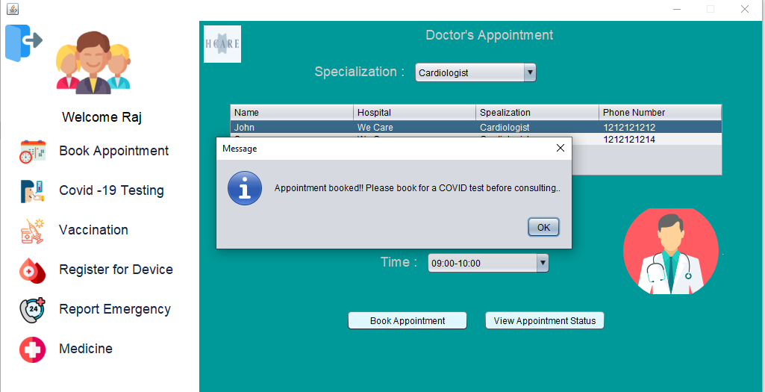

Slide 18
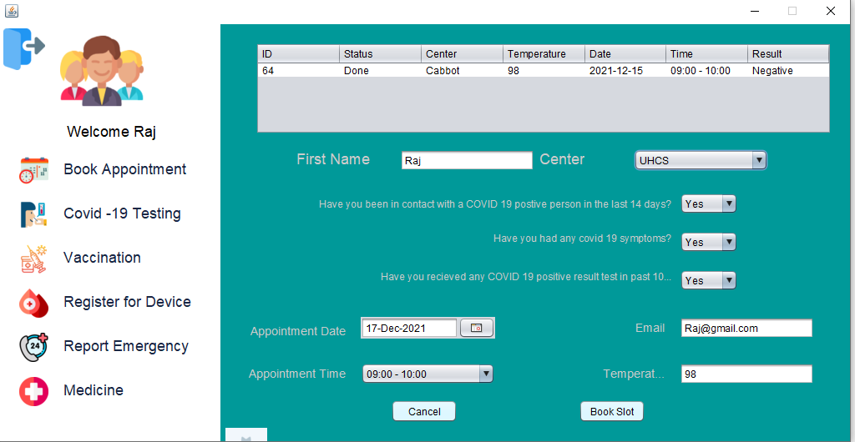

Slide 19
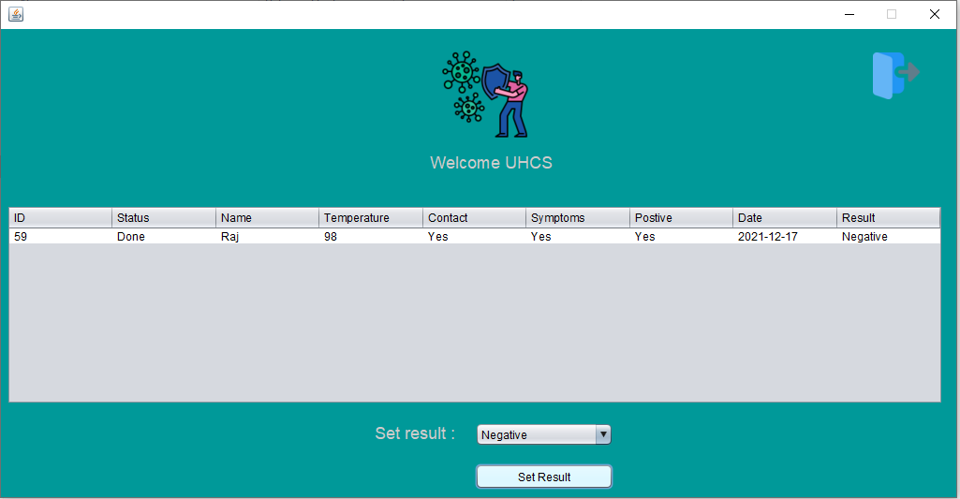

Slide 20
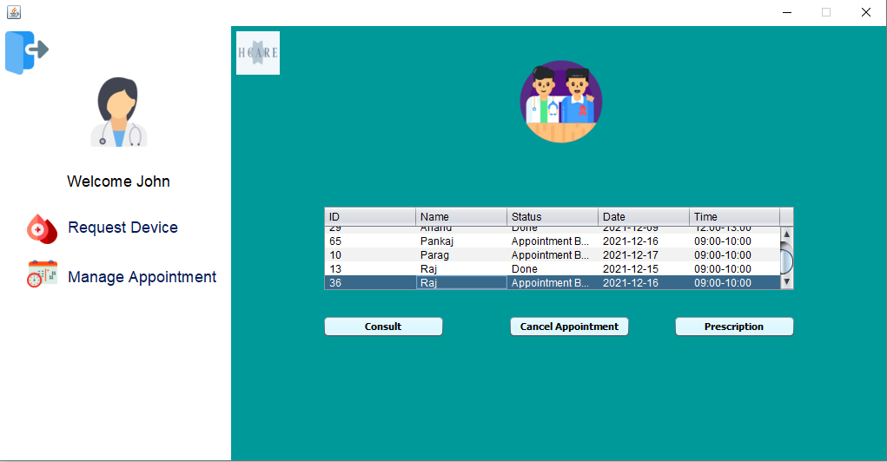

Slide 21
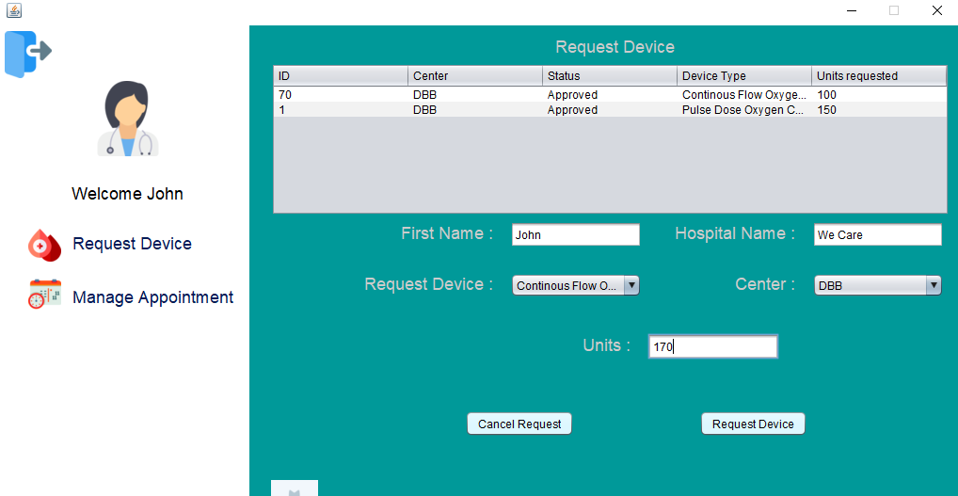

Slide 22
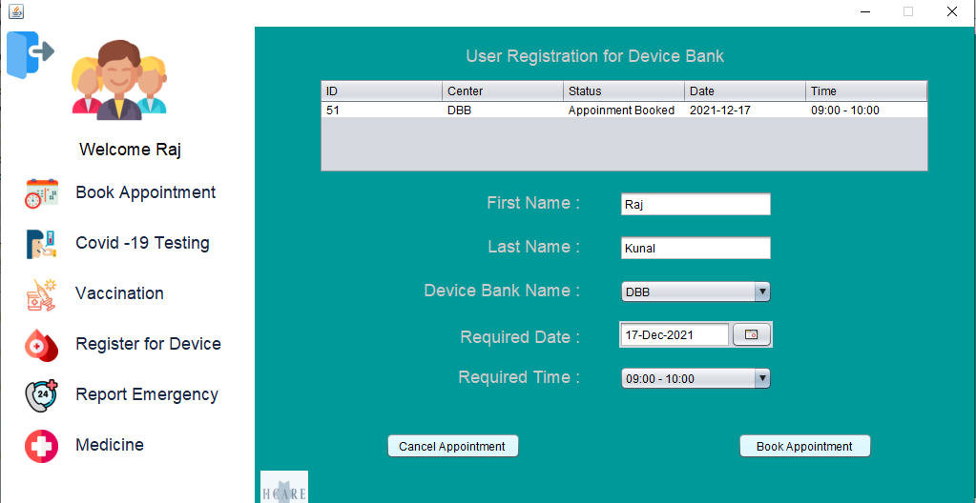

Slide 23
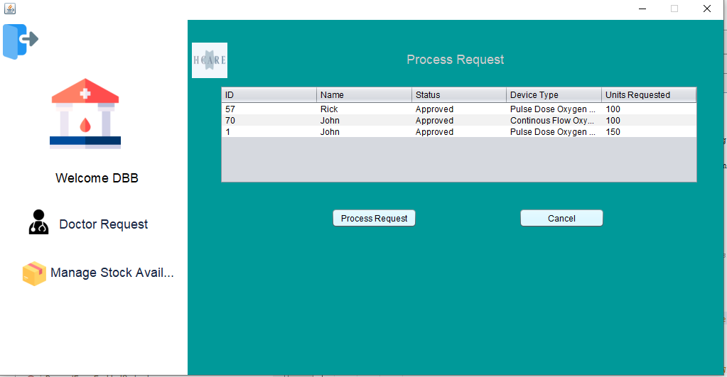

Slide 24
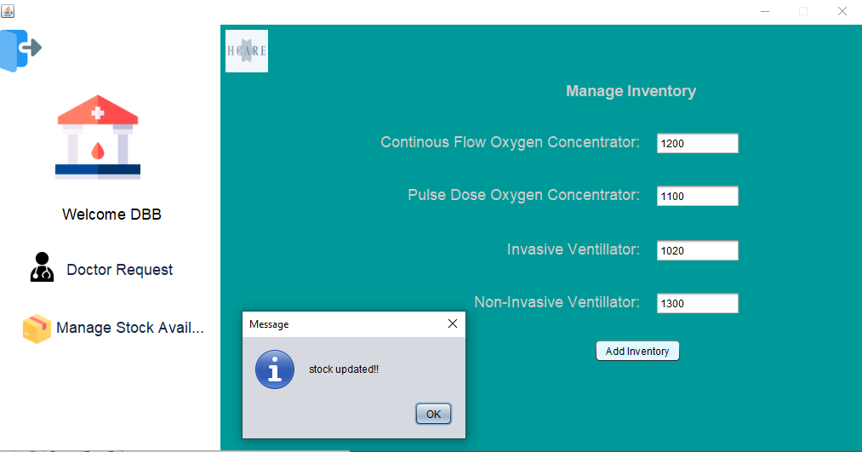

Slide 25
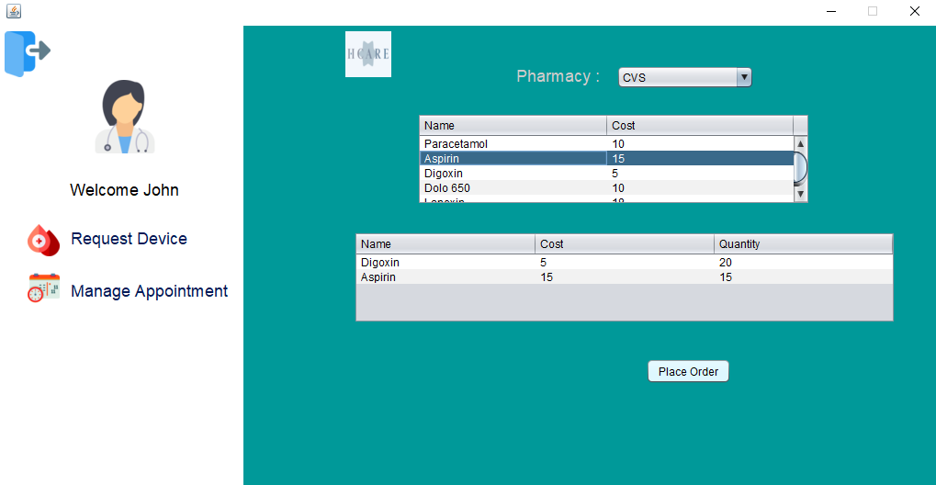

Slide 26
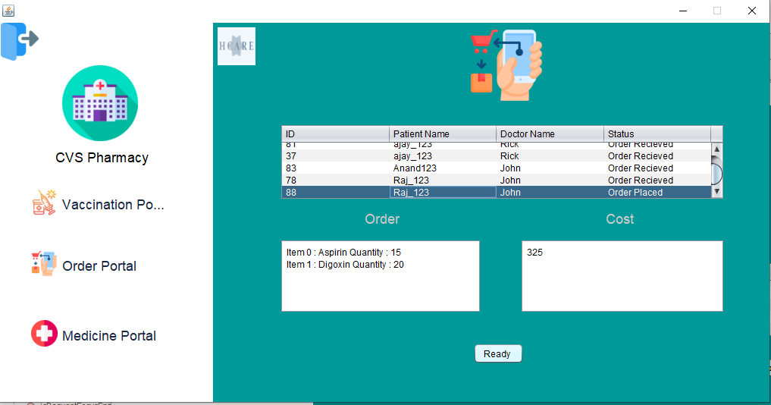

Slide 27
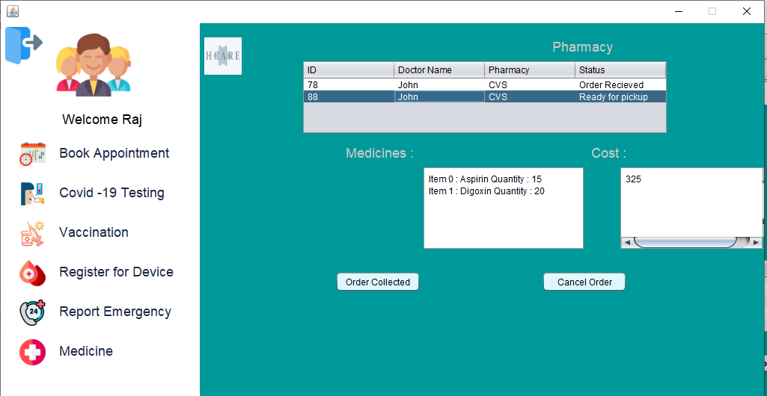

Slide 28
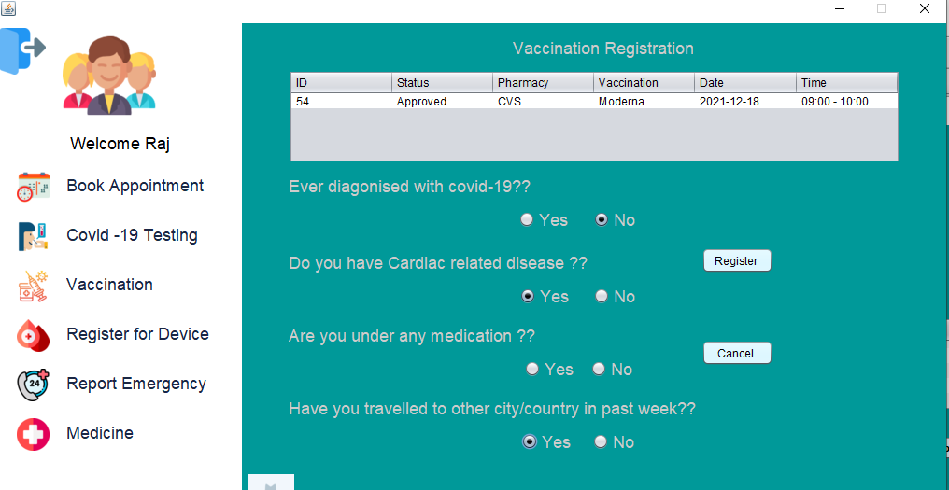

Slide 30
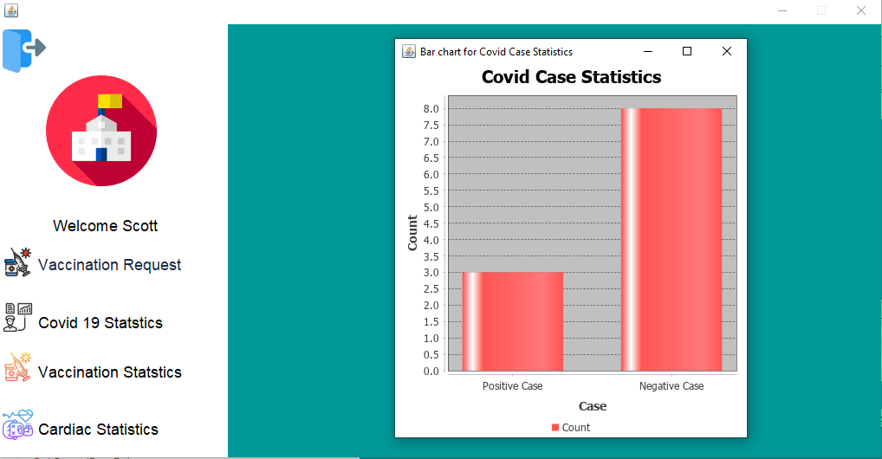

Slide 31
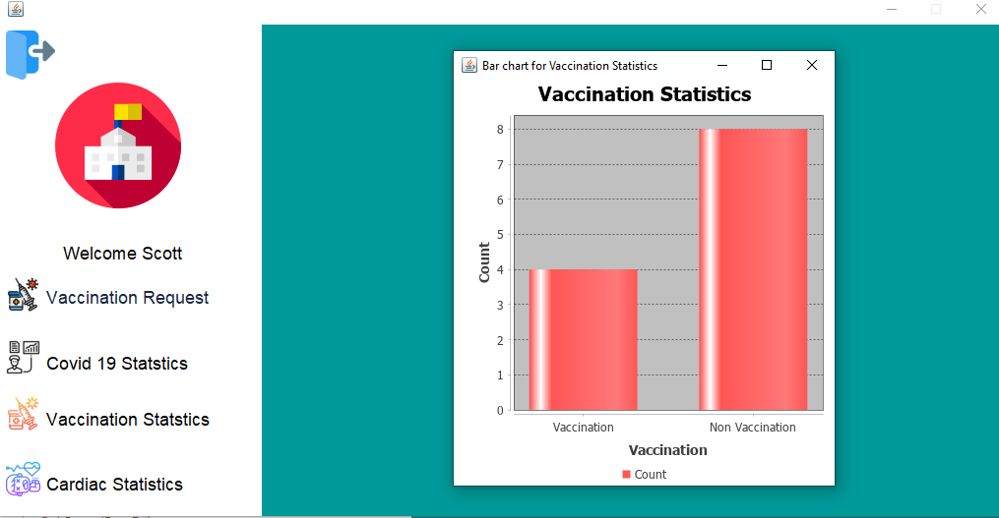

Slide 32
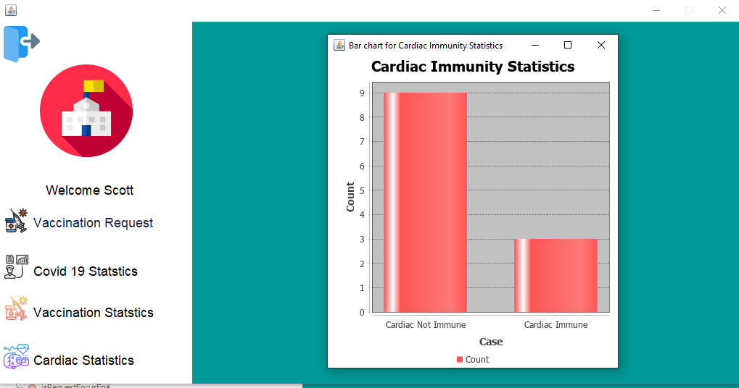

Slide 33
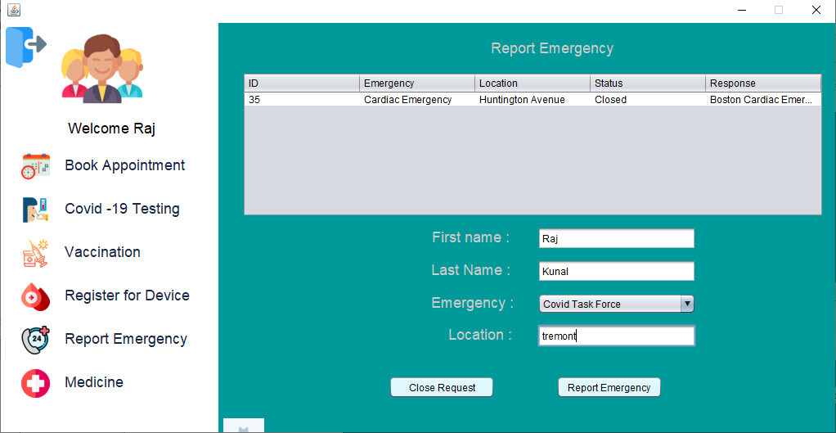

Slide 34
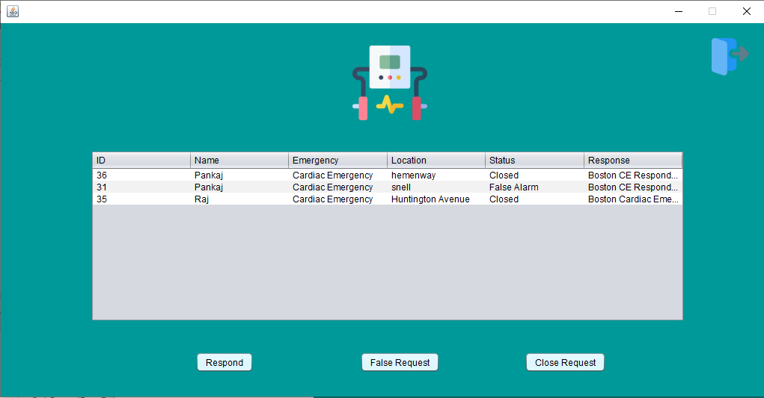

Slide 35
Thank You!!

